Slide 1
Kickstarter Crowdfunding Analysis
Kickstarter is a crowdfunding platform where creators raise funds from backers to launch projects.
It helps entrepreneurs turn ideas into reality through public funding.
This project analyzes crowdfunding data to identify success patterns.
Tools used include SQL, Excel, Tableau, and Power BI.
The goal is to derive insights for better decision-making.

Slide 2
Problem Statement
It is difficult to identify which projects will be successful.
There is a lack of clear insights into funding patterns and trends.
Different categories perform differently, but insights are unclear.
Location and time impact success but are not easily visible.
A data-driven approach is required for better decisions.

Slide 3
Data Preparation
Epoch time was converted into a readable date format for analysis.
A calendar table was created to enable time-based insights.
Financial month and quarter were added for business analysis.
Missing and inconsistent data was cleaned and structured.
All monetary values were standardized into USD.

Slide 4
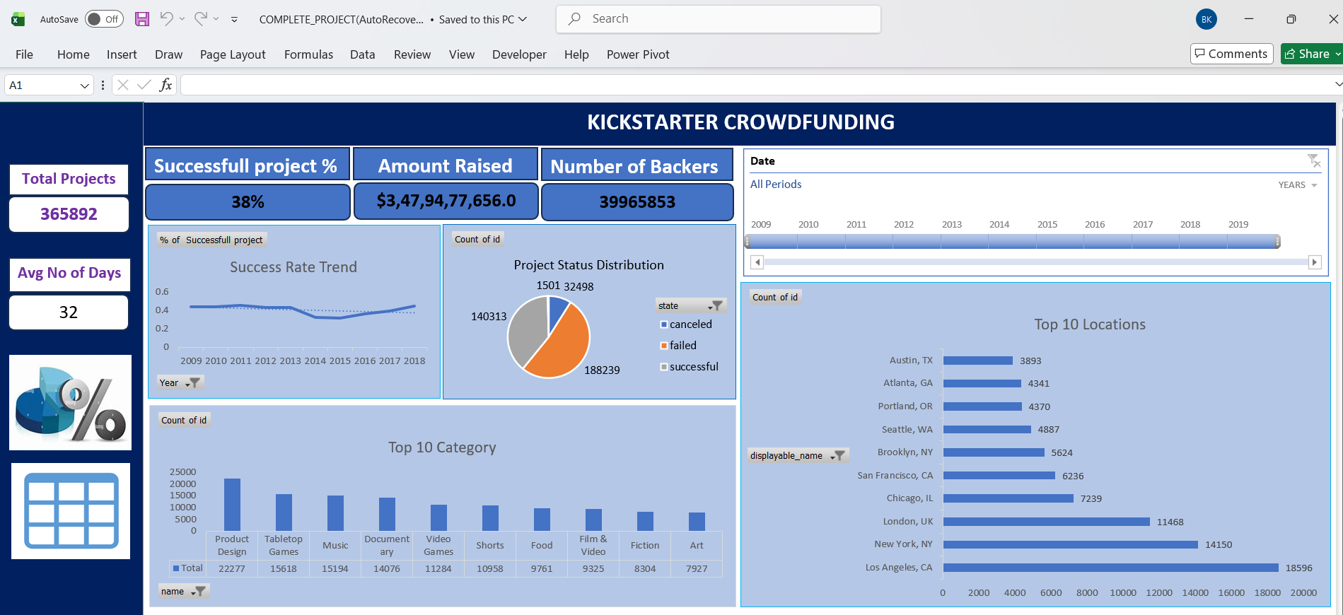
Excel Dashboard

Slide 5
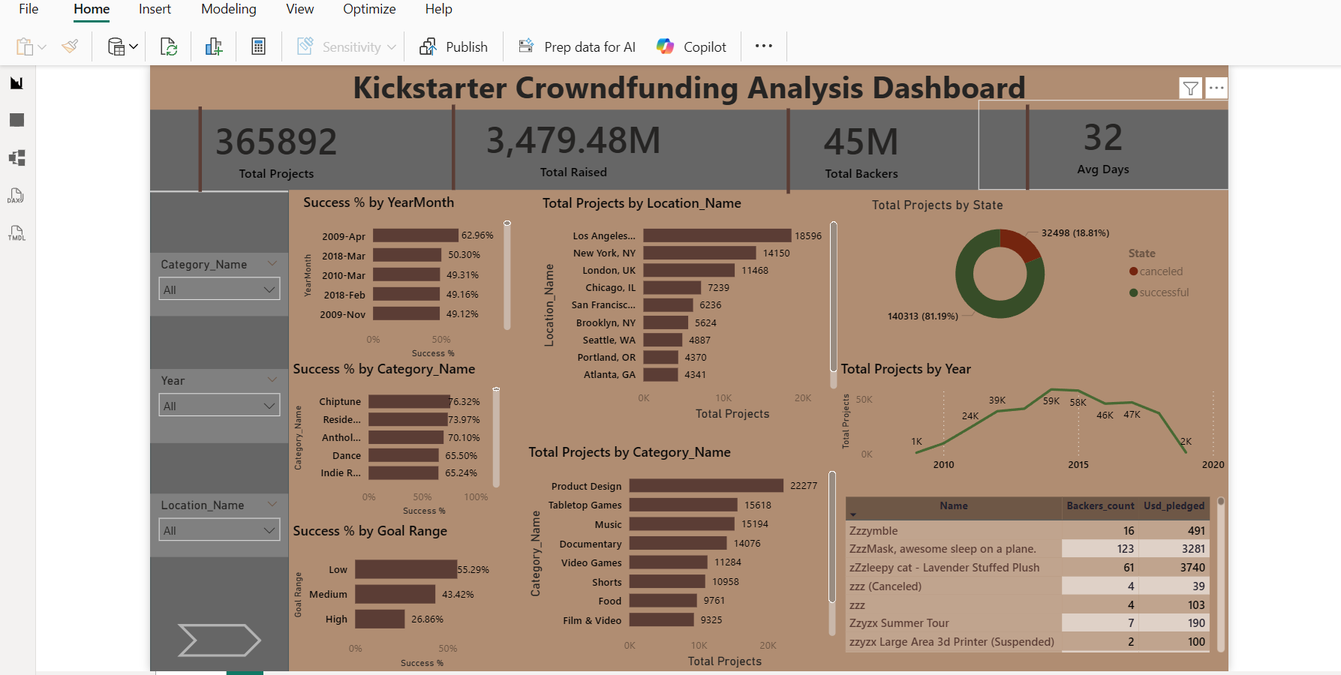
Power BI Dashboard

Slide 6
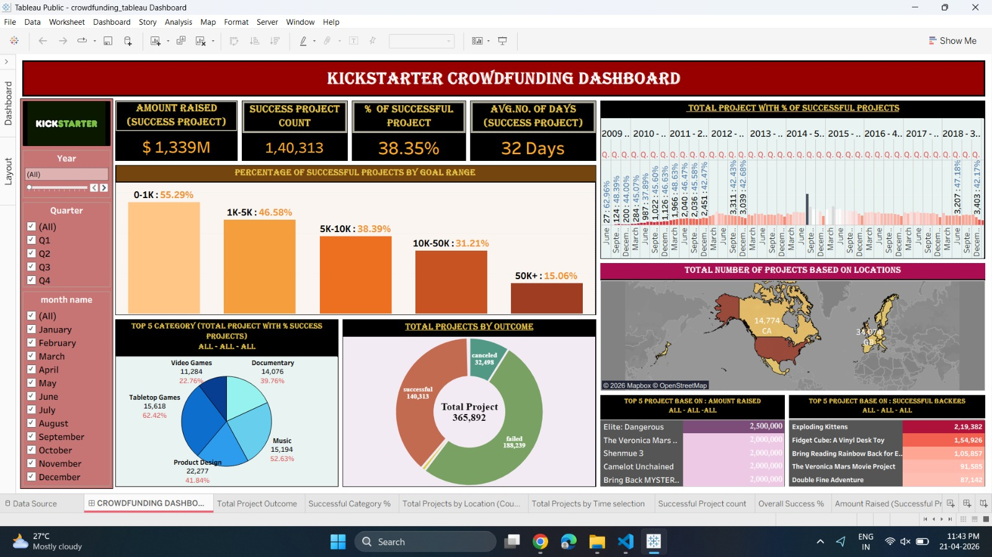
Tableau Dashboard

Slide 7
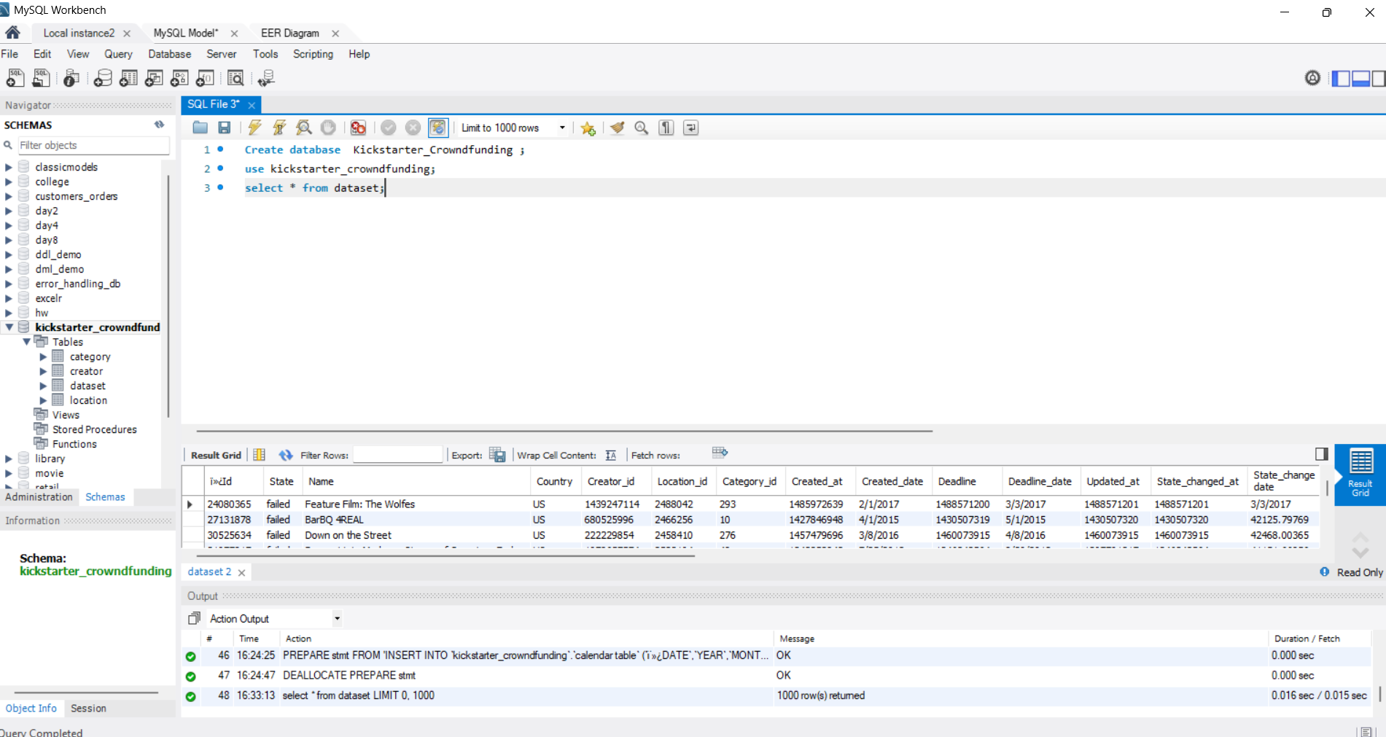
SQL Output

Slide 8
Key Insights
Projects with lower funding goals tend to have a higher success rate compared to high-budget projects.
Categories like Product Design and Games show consistently strong performance.
Major cities such as New York and Los Angeles contribute the highest number of projects.
There is a noticeable rise and fall trend in project creation over the years.
The number of backers plays a crucial role in determining project success.

Slide 9
Challenges
Converting epoch time into a standard date format was technically challenging.
Handling a large dataset required careful performance optimization.
Creating a dynamic calendar table with financial logic was complex.
Maintaining consistency across multiple tools was difficult.
Designing a clean and user-friendly dashboard required multiple iterations.

Slide 10
Advantages
The dashboard provides clear and interactive insights for users.
It enables quick identification of successful project patterns.
It supports better strategic decision-making for stakeholders.
The use of multiple tools showcases strong technical skills.
It allows dynamic filtering for deeper data exploration.

Slide 11
Disadvantages
The analysis uses a static USD conversion rate which may not reflect real-time values.
The insights depend heavily on the accuracy of the dataset.
External factors like marketing and trends are not considered.
The dashboard does not update in real-time.
Some assumptions were made during data transformation.

Slide 12
Conclusion
This project demonstrates how raw data can be transformed into meaningful insights.
It highlights key factors that influence crowdfunding success.
It helps stakeholders improve their project strategies.
It showcases end-to-end data analysis skills.
It provides a strong foundation for advanced analytics projects.

